Slide 1
Static Electricity
Physics
Unit 07
Notes:
NAD 2023 Standard EM1 (Electric fields)

Slide 2
Credits
This Slideshow was developed to accompany the textbook
OpenStax High School Physics
Available for free at https://openstax.org/details/books/physics
By Paul Peter Urone and Roger Hinrichs
2020 edition
Some examples and diagrams are taken from the OpenStax College Physics, Physics, and Cutnell & Johnson Physics 6th ed.
Slides created by
Richard Wright, Andrews Academy
rwright@andrews.edu

Slide 3
7-01 Electric Charge
In this lesson you will…
Understand where static electricity comes from.
Explain how to charge an object.
Notes:
OpenStax High School Physics 18.1
OpenStax College Physics 2e 18.1-18.2

Slide 4
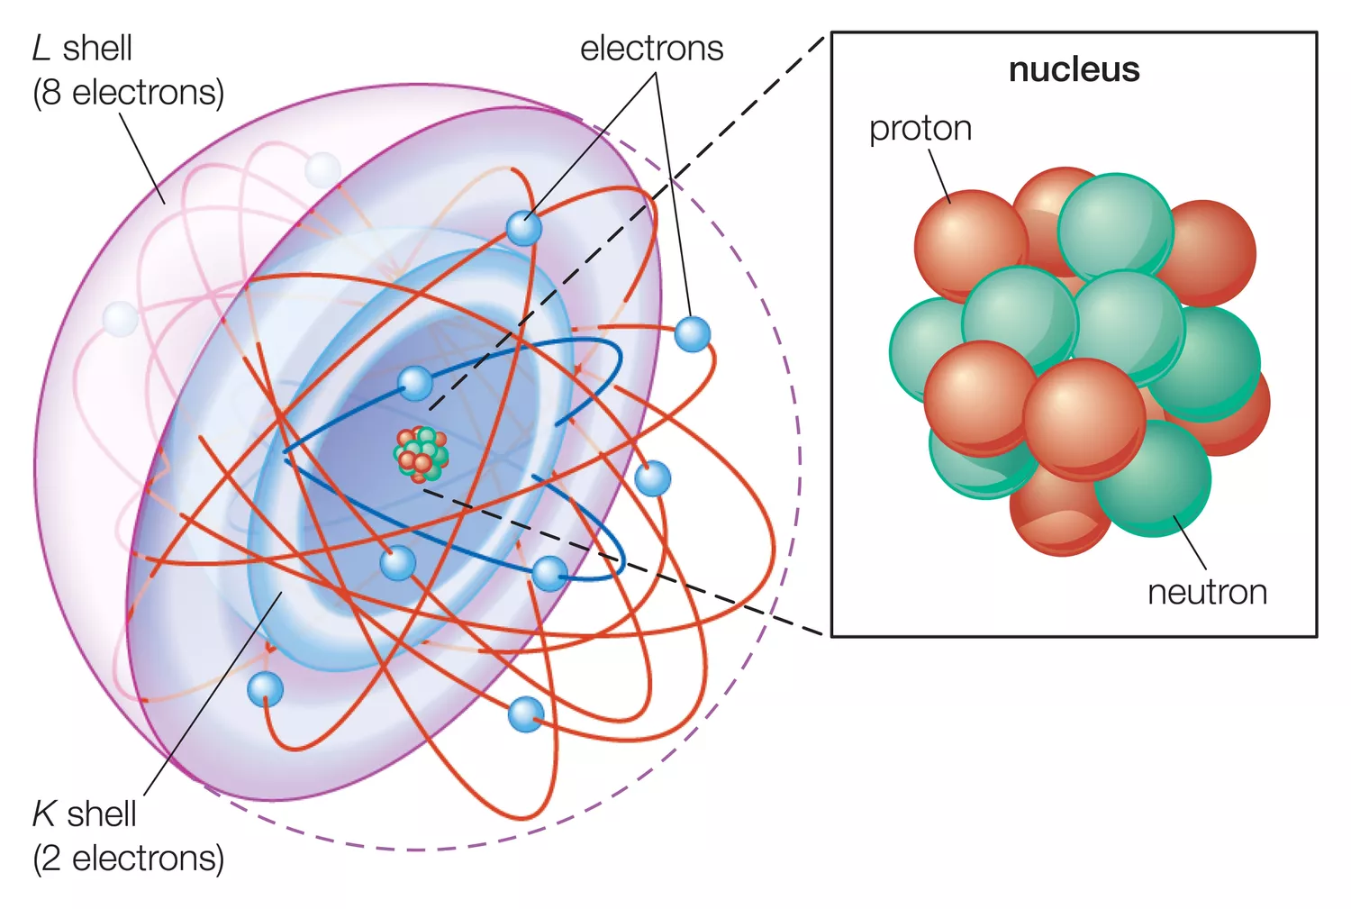
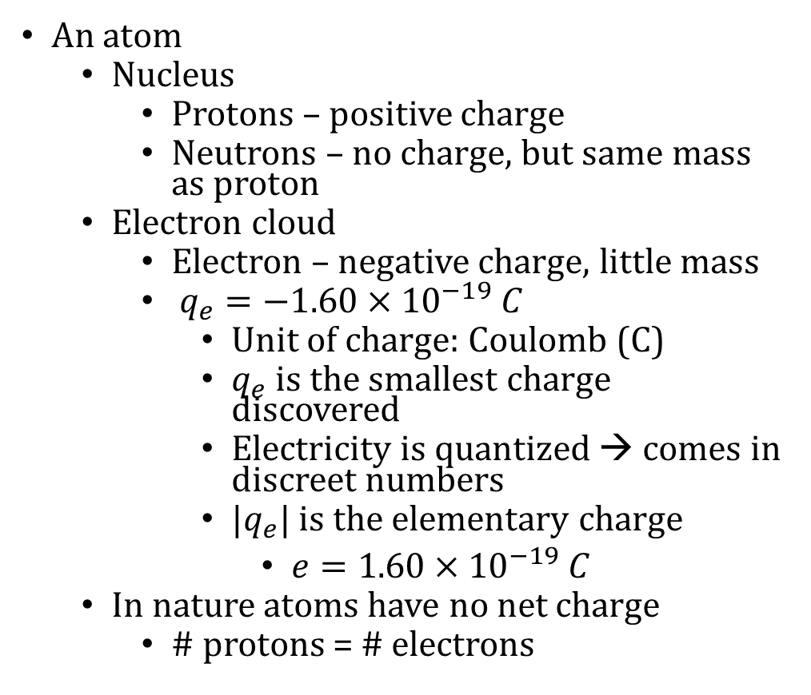
7-01 Electric Charge
An atom
Nucleus
Protons – positive charge
Neutrons – no charge, but same mass as proton
Electron cloud
Electron – negative charge, little mass
$q_{e}=−1.60×{10}^{−19} C$
Unit of charge: Coulomb (C)
$q_{e}$ is the smallest charge discovered
Electricity is quantized → comes in discreet numbers
$|q_{e}|$ is the elementary charge
$e=1.60×{10}^{−19} C$
In nature atoms have no net charge
# protons = # electrons

Slide 5
Lab 7-01
Determine what types of materials can create and hold static electricity.

Slide 6

7-01 Electric Charge
How many electrons does it take to make a charge of $−4×{10}^{−6} C$? What is their mass (m_{e} = $9.11×{10}^{−31} kg$)?
N = $2.5×{10}^{13}$electrons (a lot)
m = $2.28×{10}^{−17}$kg (very small)
Notes:
$$N=\frac{q}{e} → N=\frac{4×{10}^{−6} C}{1.6×{10}^{−19} C}=2.5×{10}^{13}$$
$$m=2.5×{10}^{13} \left(9.11×{10}^{−31} kg\right)=2.28×{10}^{−17} kg$$

Slide 7
7-01 Electric Charge
Law of Conservation of Charge
During any process, the net electrical charge of a closed system remains constant
Like charges repel
Unlike charges attract
The attraction and repulsion are forces and can be used with Newton’s Laws and other dynamics problems
Notes:
When you rub a balloon on your hair, the balloon steals electrons from the hair. The balloon gets a negative charge and the hair gets a positive charge.
When the balloon takes electrons from the hair, each hair is positively charged. It stands on end because the like positive charges repel
The balloon with the extra electrons sticks to other objects because it has a charge and the other objects don’t. The unlike charges attract

Slide 8
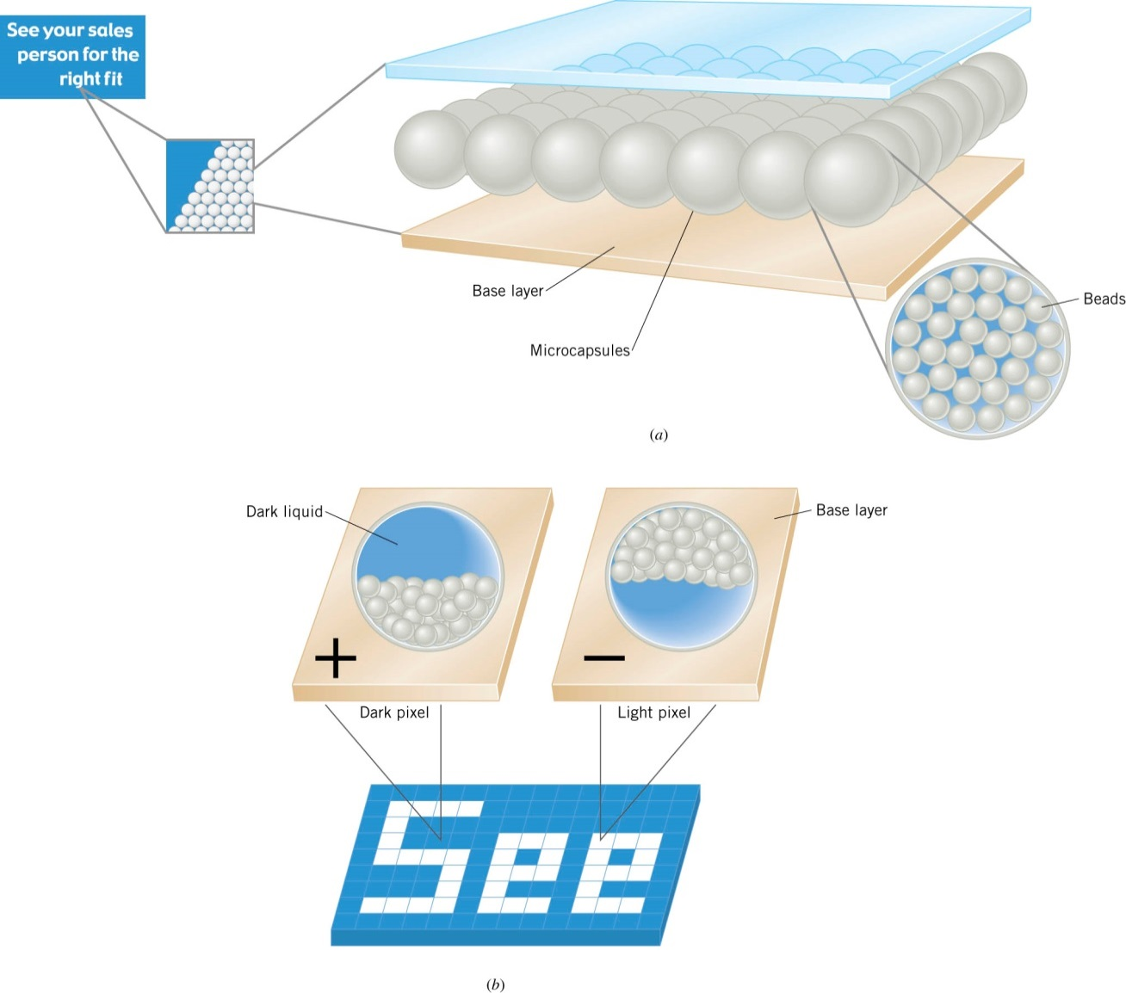
7-01 Electric Charge
Electric Ink
Notes:
This is different than LCD (in LCD the material is naturally transparent, the charge makes it become opaque)
Made of two layers (base and transparent top)
Microcapsules diameter of hair contain white charged beads and dark liquid.
The base layer is electrically charged (some pixels (picture element) are dark because the beads are attracted to the base layer and some are white because the beads are repelled by the base layer)

Slide 9
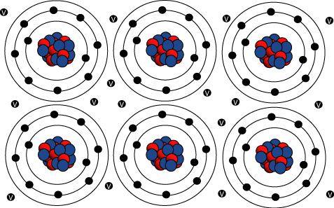
7-01 Electric Charge
Electricity can flow through objects
Conductors let electrons flow easily
Most heat conductors are also electrical conductors
Metals
Insulators are very poor conductors
Rubber
Plastic
Wood
Notes:
Metals make good conductors because of metallic bonds (chemistry) where the electrons are not strongly attached to the individual nuclei. This happens partly because the outer most layer of electrons is so far away from the nucleus, there isn’t much attraction.
Insulators are made of atoms that hold tightly to their electrons i.e. their electron shells are full or almost full.
Hence electrical wires are coated in plastic

Slide 10
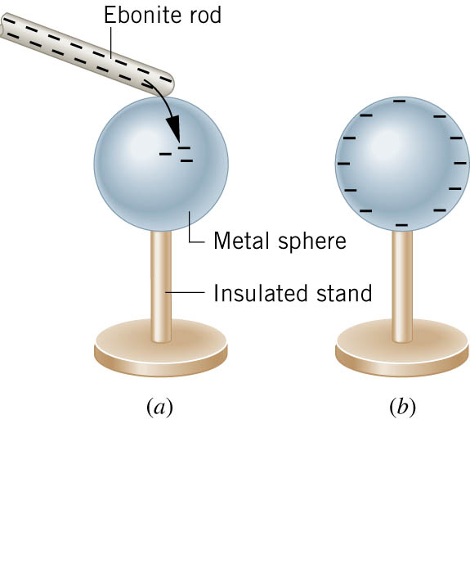
7-01 Electric Charge
Charging by contact
Negative charged rod gives some electrons to sphere
Sphere becomes negatively charged until charges are equal

Slide 11

7-01 Electric Charge
Static Electricity Charging
When two insulators are rubbed together
One steals the electrons from the other
It becomes negatively charged
The other becomes positively charged
Balloons and Static Electricity simulation. (http://www.openstaxcollege.org/l/28balloons)

Slide 12
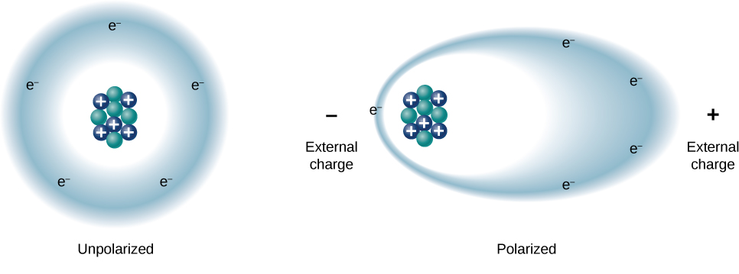
7-01 Electric Charge
Polarization
Insulators
Electrons are not free to move away from the atoms or molecule
When a charge is brought near, the electrons move to one side of the atom/molecule so that more electrons are on that side
One side is negative, and the other side is more positive

Slide 13
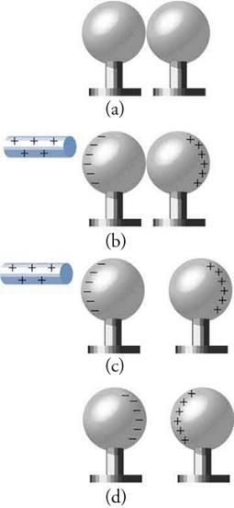
7-01 Electric Charge
Charge by Induction
Charge without touching
Charged rod comes near neutral sphere
The like charges are repelled to other sphere
The spheres are separated
The rod is removed
Spheres are charged

Slide 14
07-01 Practice work
Try charging your way through these problems
Read
OpenStax College Physics 2e 18.3
OR
OpenStax High School Physics 18.2

Slide 15
7-02 Coulomb’s Law
In this lesson you will…
Find the force between two point-charges.
Find the force on one charge from two other charges.
Notes:
OpenStax High School Physics 18.2
OpenStax College Physics 2e 18.3

Slide 16
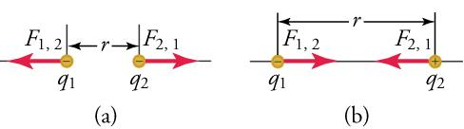
7-02 Coulomb’s Law
Point charges exert force on each other
Related to the size of the charges and the distance between them
If the signs are same force repels
If the signs are opposite force attracts
Force of the first to the second is equal and opposite of the second to the first
Newton’s Third Law

Slide 17
7-02 Lab
Do the lab to observe properties of electric force

Slide 18
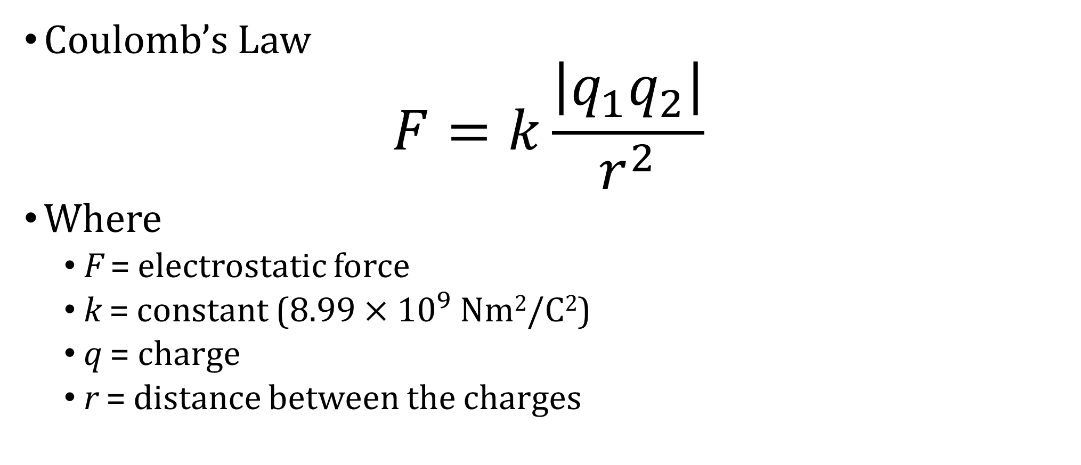
7-02 Coulomb’s Law
Coulomb’s Law
$$F=k\frac{\left|q_{1}q_{2}\right|}{r^{2}}$$
Where
F = electrostatic force
k = constant ($8.99×{10}^{9}$Nm²/C²)
q = charge
r = distance between the charges

Slide 19
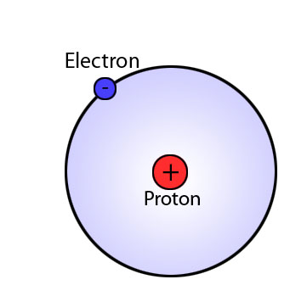

7-02 Coulomb’s Law
In a hydrogen atom, the electron ($q=−1.60×{10}^{−19}$ C) is $5.29×{10}^{−11}$ m away from the proton of equal charge magnitude. Find the electrical force of attraction.
$F=8.22×{10}^{−8}$ N
Notes:
$$F=\frac{\left(8.99×{10}^{9}\frac{Nm^{2}}{C^{2}}\right)\left(\left(1.6×{10}^{−19} C\right)\left(1.6×{10}^{−19} C\right)\right)}{{\left(5.29×{10}^{−11} m\right)}^{2}}=8.22×{10}^{−8} N$$

Slide 20
7-02 Coulomb’s Law
Coulomb’s Law – other notes
Notice the similarity to Newton’s Law of Universal Gravitation
Notice that F ∝ 1/r²
Distance increases by 4, force decreases by 16

Slide 21
7-02 Coulomb’s Law
Force on 1 charge by 2 others
Work in two parts
Find force of attraction by one of the points
Find force of attraction by the other point
Add the force vectors
REMEMBER!!!!! → you have to add the x and y components!!!!!

Slide 22
7-02 Coulomb’s Law
There are three charges in a straight line
q₁ = +2μC at x = -0.1 m
q₂ = −3 μC at x = 0 m
q₃ = +5 μC at x = 0.3 m
What is the force on q₂?
F = −3.89 N
Notes:
$F_{12}=8.99×{10}^{9}\frac{Nm^{2}}{C^{2}}\frac{\left(2×{10}^{−6} C\right)\left(3×{10}^{−6} C\right)}{{\left(0.1 m\right)}^{2}} = −5.39 N$(neg because pulling in – direction)
$F_{23}=8.99×{10}^{9}\frac{Nm^{2}}{C^{2}}\frac{\left(5×{10}^{−6} C\right)\left(3×{10}^{−6} C\right)}{{\left(0.3 m\right)}^{2}} = 1.50 N$ (pos because pulling in + direction)
$F=F_{12}+F_{23}=−5.39 N+1.50 N=−3.89 N$

Slide 23
7-02 Coulomb’s Law
There are three charges
q₁ = +2μC at (0, 0.3) m
q₂ = −3 μC at (0, 0) m
q₃ = +5 μC at (0.1, 0.2) m
What is the force on q₂?
F = 3.247 N @ 68.1° above horizontal
Notes:
$$F_{12}=8.99×{10}^{9}\frac{Nm^{2}}{C^{2}}\frac{\left(2×{10}^{−6} C\right)\left(3×{10}^{−6} C\right)}{{\left(0.3 m\right)}^{2}} = .599 N$$
$$r=\sqrt{{0.1}^{2} + {0.2}^{2}} = .2236 m$$
$$=\cos^{−1} \left(\frac{.1}{.2236}\right) = 63.4 deg$$
$$F_{23}=8.99×{10}^{9}\frac{Nm^{2}}{C^{2}}\frac{\left(5×{10}^{−6} C\right)\left(3×{10}^{−6} C\right)}{{\left(0.2236 m\right)}^{2}} = 2.70 N$$
$$x−components: F_{12}=0 N, F_{23}=2.70\cos{63.4°}=1.209 N$$
$$ADD:0 N+1.209 N=1.209 N$$
$$y−component: F_{12}=0.599 N, F_{23}=2.70\sin{63.4°}=2.414 N$$
$$ADD:0.599 N + 2.414 N = 3.013 N$$
$$r=\sqrt{1.2092 + 3.0132}=3.247 N$$
$$θ=\cos^{−1}{\frac{1.209}{3.247}}=68.1°$$

Slide 24
7-02 Practice Work
Charge these problems to your grade
Read
OpenStax College Physics 2e 18.4-18.5
OR
OpenStax High School Physics 18.3

Slide 25
7-03 Electric Field
In this lesson you will…
Find the electric field near a charge.
Draw electric fields near charged objects.
Notes:
OpenStax High School Physics 18.3
OpenStax College Physics 2e 18.4-18.5

Slide 26
7-03 Electric Field
We can use a test charge to determine how the surrounding charges generate a force
Pick a small test charge so it doesn’t change the surrounding charge orientation

Slide 27

7-03 Electric Field
A test charge ($q_{0}=1.0×{10}^{−10} C$) experiences a force of $2×{10}^{−9} N$ when placed near a charged sphere. Determine the Force per Coulomb that the charge experiences and predict the force on a $2 C$ charge.
$\frac{F}{q_{0}}=20 N/C$
$F=40 N$
Notes:
$$\frac{F}{q_{0}}=\frac{2×{10}^{−9} N}{1×{10}^{−10} C}=20\frac{N}{C}$$
$$F=20\frac{N}{C} (2 C)=40 N$$

Slide 28
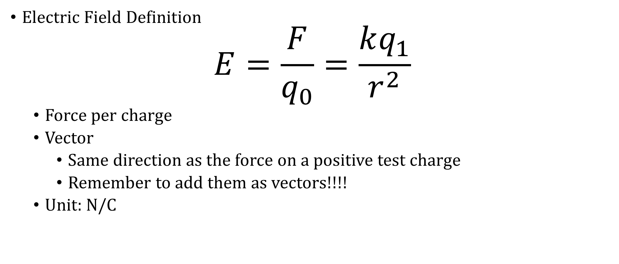
7-03 Electric Field
Electric Field Definition
$$E=\frac{F}{q_{0}}=\frac{kq_{1}}{r^{2}}$$
Force per charge
Vector
Same direction as the force on a positive test charge
Remember to add them as vectors!!!!
Unit: N/C
Notes:
The surrounding charges create the electric field at a given point
As we will see, the test charge does not affect the electric field

Slide 29
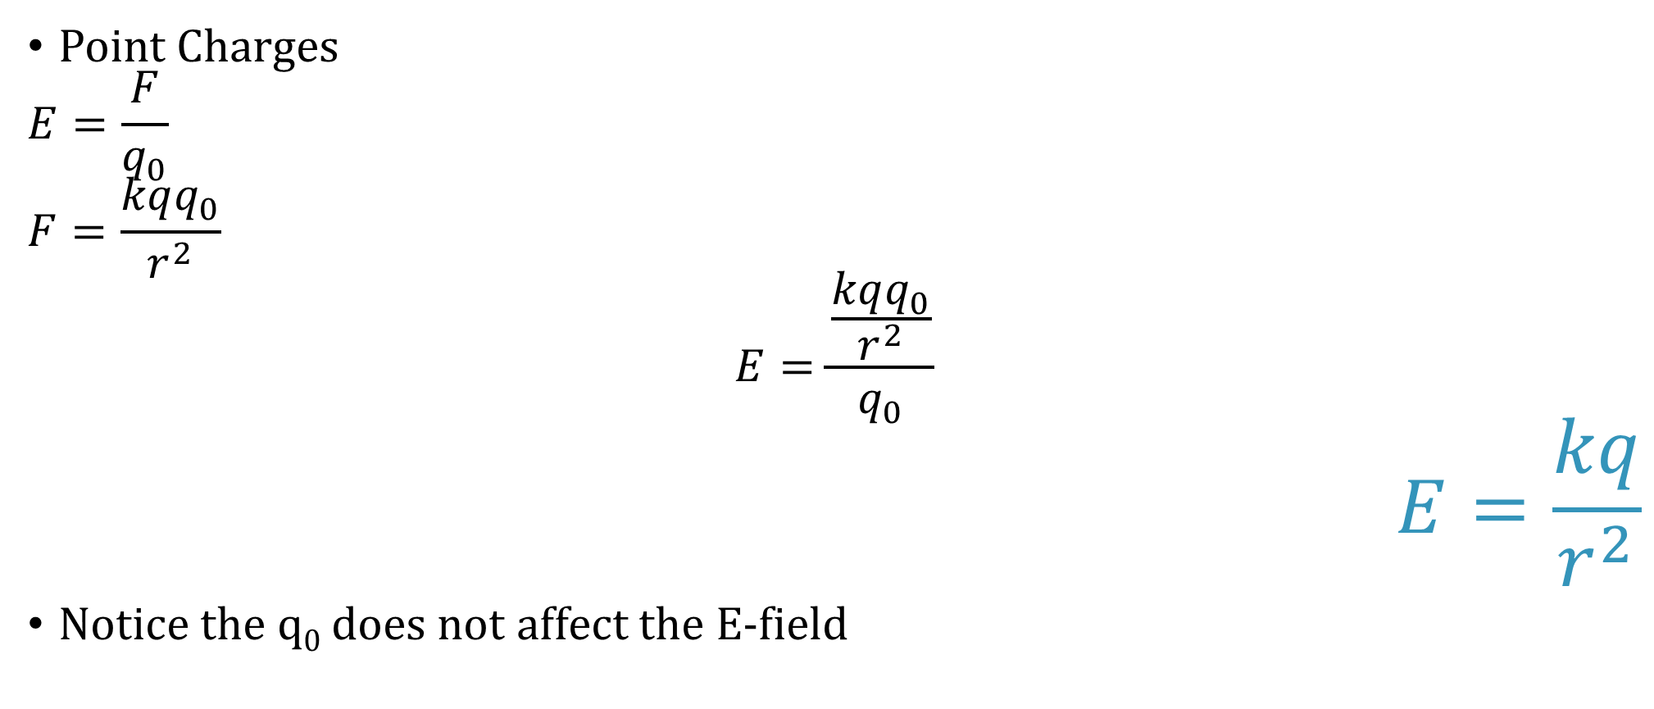
7-03 Electric Field
Point Charges
$$E=\frac{F}{q_{0}}$$
$$F=\frac{kqq_{0}}{r^{2}}$$
$$E=\frac{\frac{kqq_{0}}{r^{2}}}{q_{0}}$$
$$E=\frac{kq}{r^{2}}$$
Notice the q₀ does not affect the E-field

Slide 30

7-03 Electric Field
There is a point charge of $q=2×{10}^{−8} C$. Determine the E-field at 0.50 m away using a test charge of $1×{10}^{−10} C$.
E = 719 N/C
Notes:
$$E=\frac{kq}{r^{2}}$$
$$E=\frac{\left(8.99×{10}^{9}\frac{Nm^{2}}{C^{2}}\right)\left(2×{10}^{−8} C\right)}{{\left(0.50 m\right)}^{2}}=719.2 N/C$$

Slide 31
7-03 Electric Field
There are two point charges of q₁ = 4 C and q₂ = 8 C and they are 10 m apart. Find point where E = 0 between them.
d = 5.85 m from q₂ towards q₁
Notes:
Pick the distance from the first as d and the distance from the second as 10 – d
Set E-fields equal to each other
$$\frac{k8 C}{d^{2}}=\frac{k4 C}{{\left(10−d\right)}^{2}}$$
$$\frac{8}{d^{2}}=\frac{4}{{\left(10−d\right)}^{2}}$$
$$8{\left(10−d\right)}^{2}=4d^{2}$$
$$2\sqrt{2}\left(10−d\right)=±2d$$
$$28.2−2.82d=±2d$$
$$Take +: 28.2−2.82d=2d → 28.2=4.82d → d=5.85$$
$$Take −: 28.2−2.82d=−2d → 28.2=0.82 d → d=34.39$$
Answer is 5.85

Slide 32
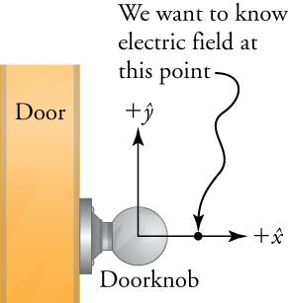
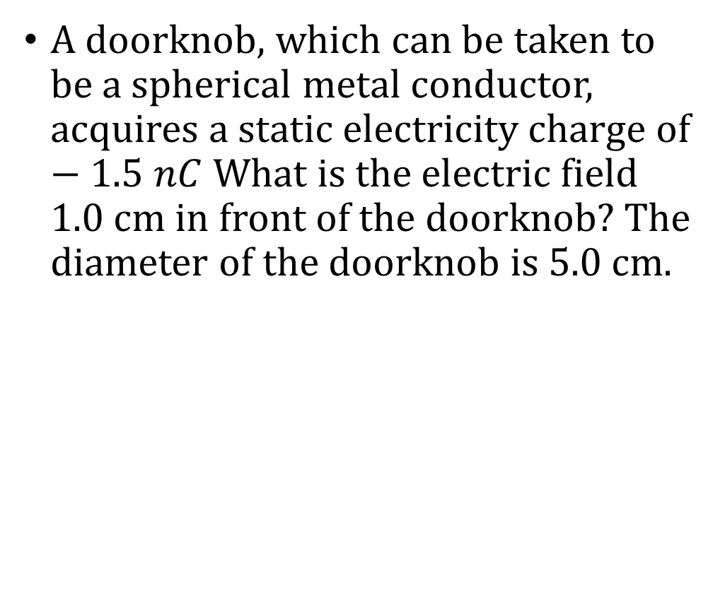
A doorknob, which can be taken to be a spherical metal conductor, acquires a static electricity charge of $−1.5 nC$ What is the electric field 1.0 cm in front of the doorknob? The diameter of the doorknob is 5.0 cm.
Notes:
Like gravity, electric force and field are taken from the center of a sphere. So the distance r is the radius plus the 1 cm away from the surface.
$$r=0.025 m+0.01 m=0.035 m$$
$$E=\frac{kq}{r^{2}}$$
$$E=\frac{\left(8.99×{10}^{9}\frac{Nm^{2}}{C^{2}}\right)\left(1.5×{10}^{−9} C\right)}{{\left(0.035 m\right)}^{2}}=1.10×{10}^{4}\frac{N}{C}$$
Positive charge at this location will be attracted towards the knob on the left, so the answer is $1.10×{10}^{4}\frac{N}{C}$ to the left.

Slide 33
7-03 Electric Field
It would be nice to have some kind of map to show the E-field in space
Rules
Lines begin at positive charges only
Lines end at negative charges only
The number of lines entering or leaving a charge is proportional to the size of charge
Lines don’t cross each other
Lines leave surfaces at 90 degrees
Notes:
Spread out lines → weak E-field
Close lines → strong E-field
Lines don’t cross because there is only one value of E at one point

Slide 34
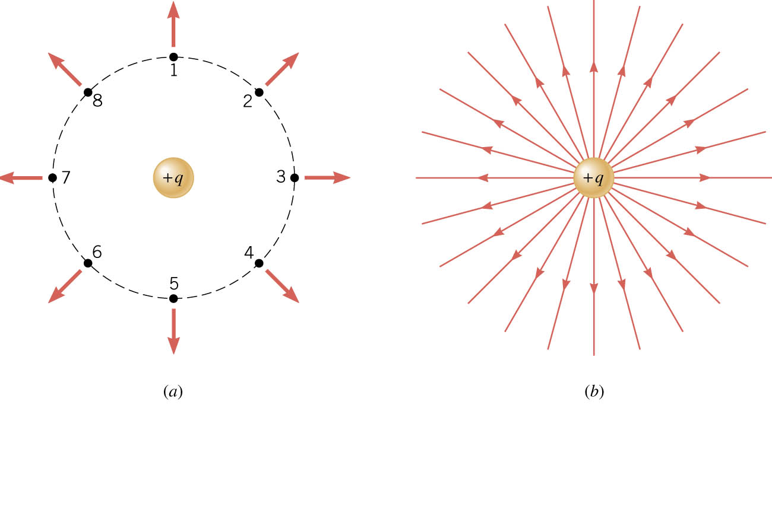
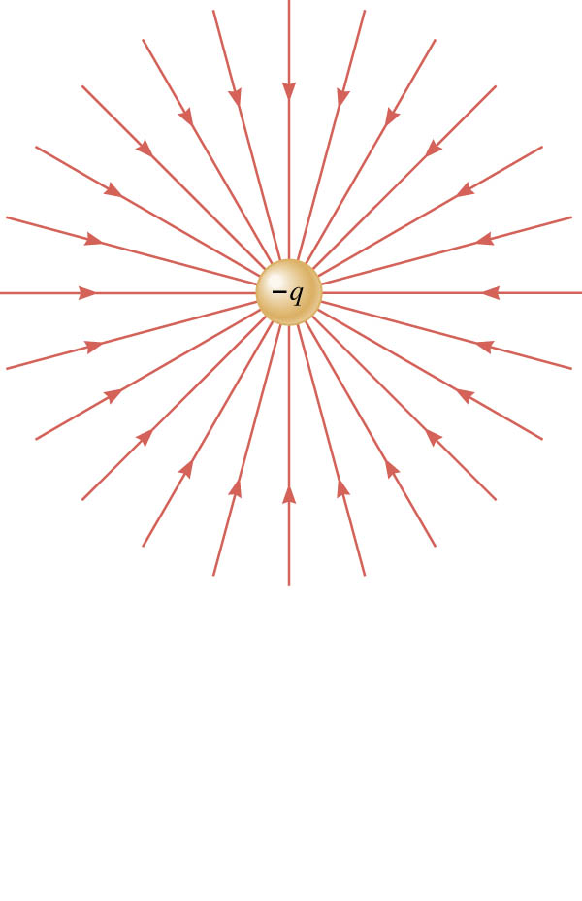
7-03 Electric Field
Notes:
Made by putting test charge in points and seeing direction and strength of E-field

Slide 35
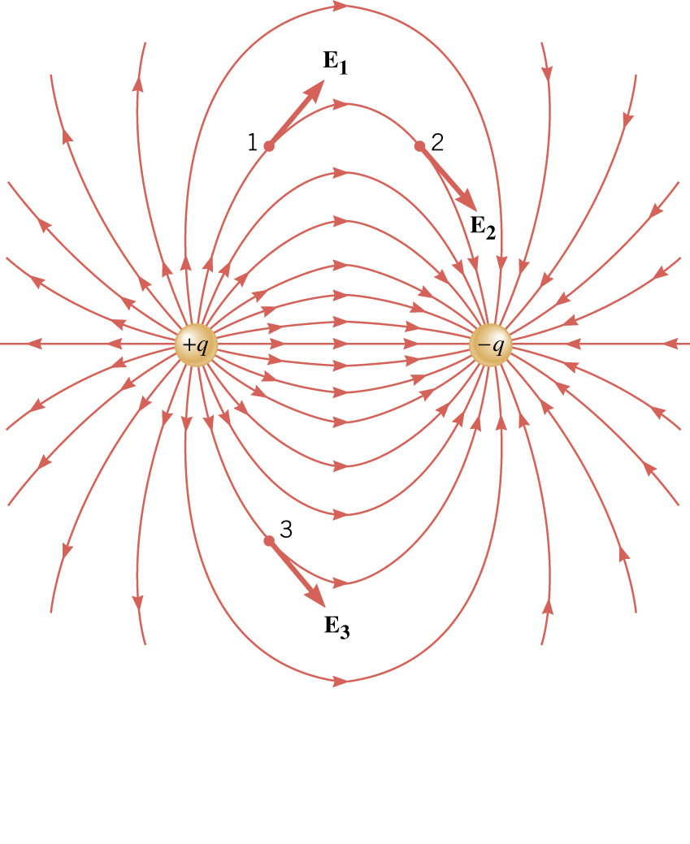
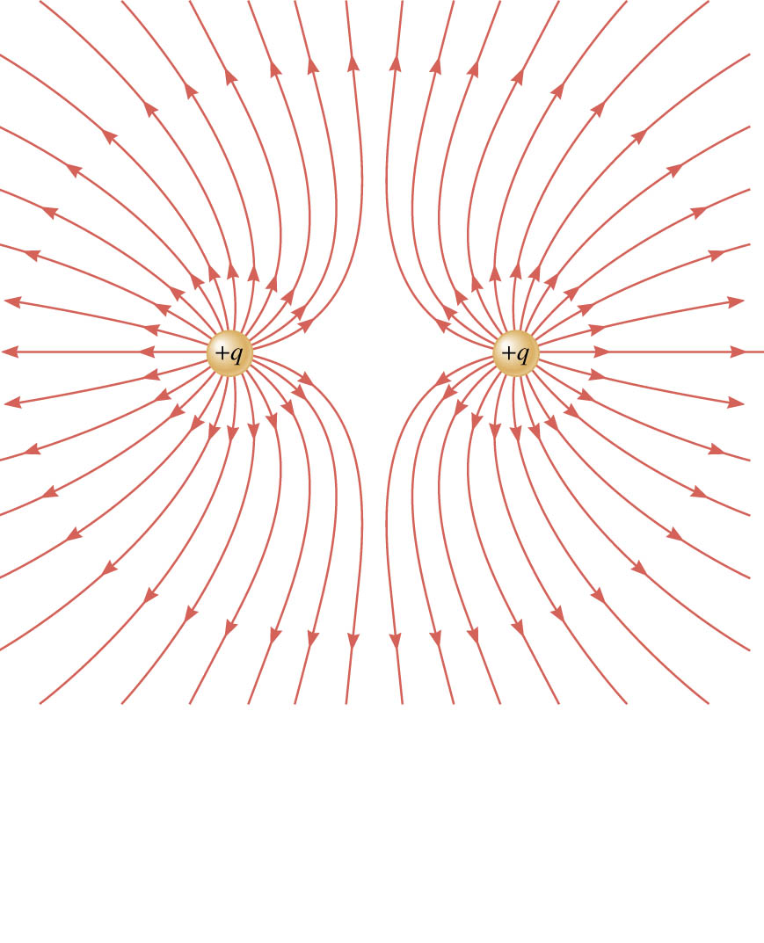
7-03 Electric Field

Slide 36
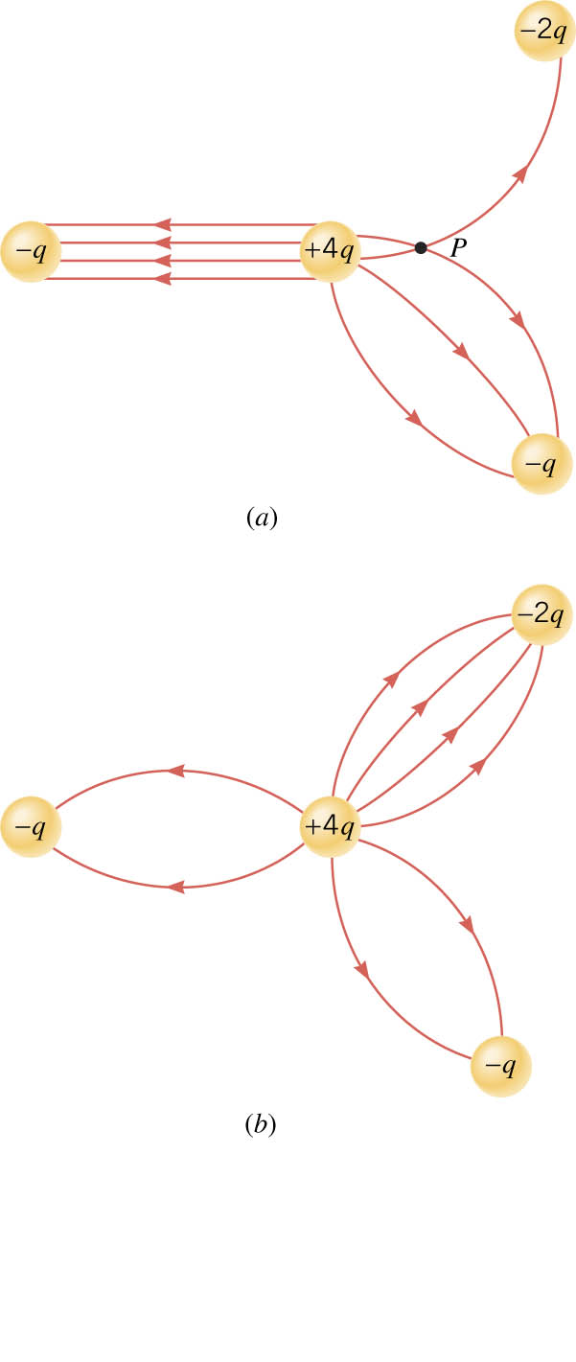
7-03 Electric Field
What is wrong here?
Notes:
Lines on left should be curved→ as is the charge would constant between them, should depend on distance
Lines cross at point P
Number of lines should be proportional to charge 1:4:2:1 or 2:8:4:2 to make symmetry

Slide 37
07-03 Lab
Create your own electric field map

Slide 38
7-03 Practice Work
Electrify your brain and answer these problems
Read
OpenStax College Physics 2e 19.1-19.3
OR
OpenStax High School Physics 18.4

Slide 39
7-04 Electric Potential
In this lesson you will…
Find the electric potential near a charge.
Understand the relationship between E-field, electric potential energy, and electric potential.
Notes:
OpenStax High School Physics 18.4
OpenStax College Physics 2e 19.1-19.3

Slide 40
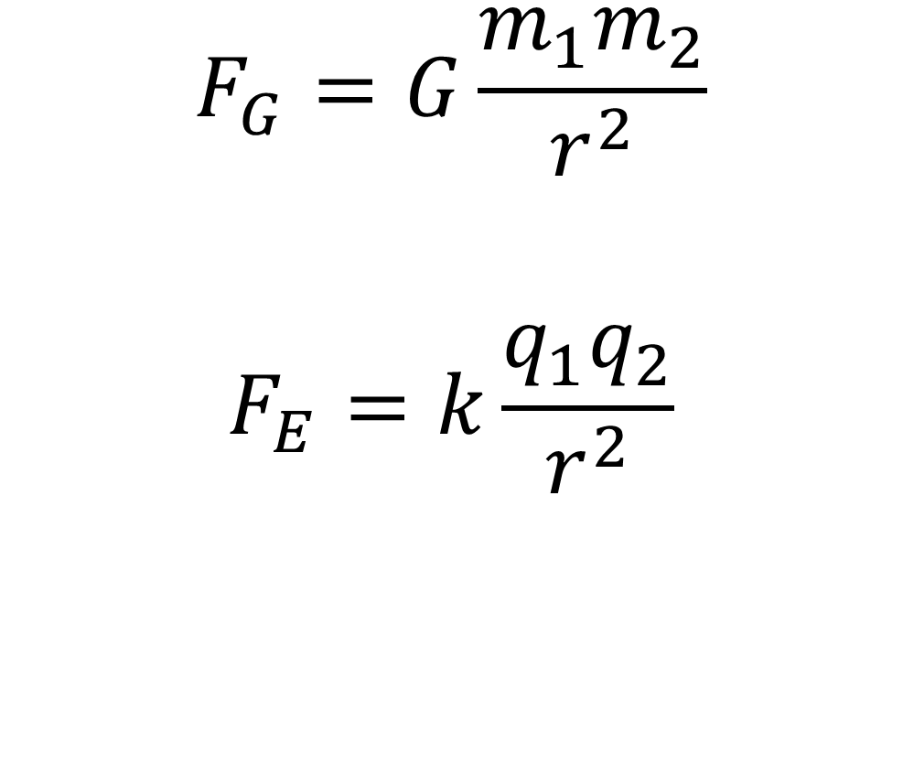
7-04 Electric Potential
Change in PE due to Gravity
Force of gravity is conservative
W = mgh₀ – mgh_{f} = PE₀ – PE_{f}
Change in PE due to Electrical Force
Electrical Force is conservative
W = PE₀ − PE_{f}
$$F_{G}=G\frac{m_{1}m_{2}}{r^{2}}$$
$$F_{E}=k\frac{q_{1}q_{2}}{r^{2}}$$

Slide 41
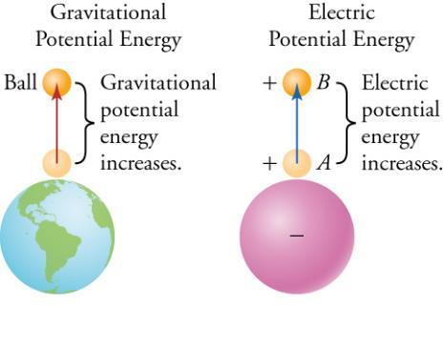
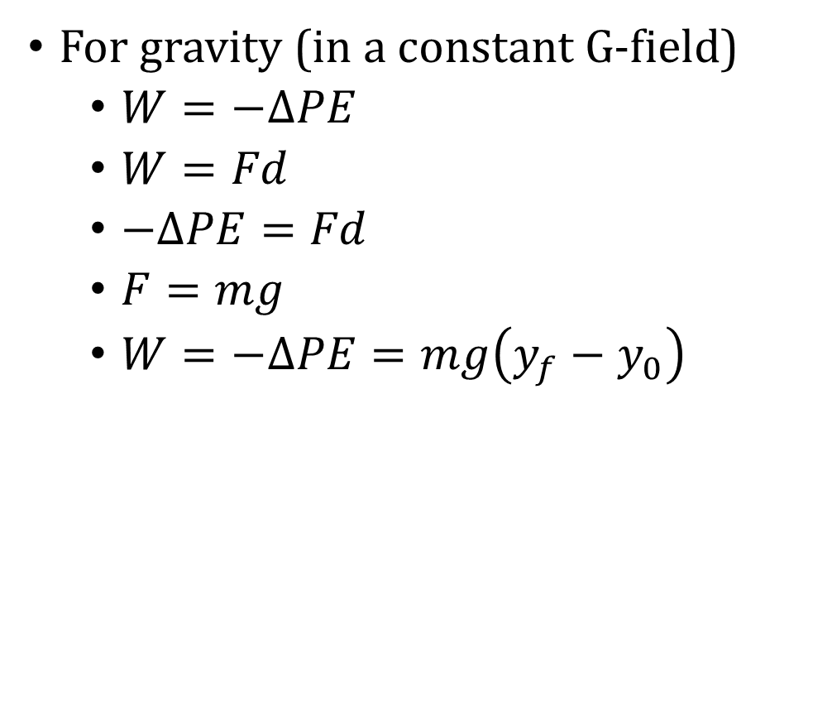
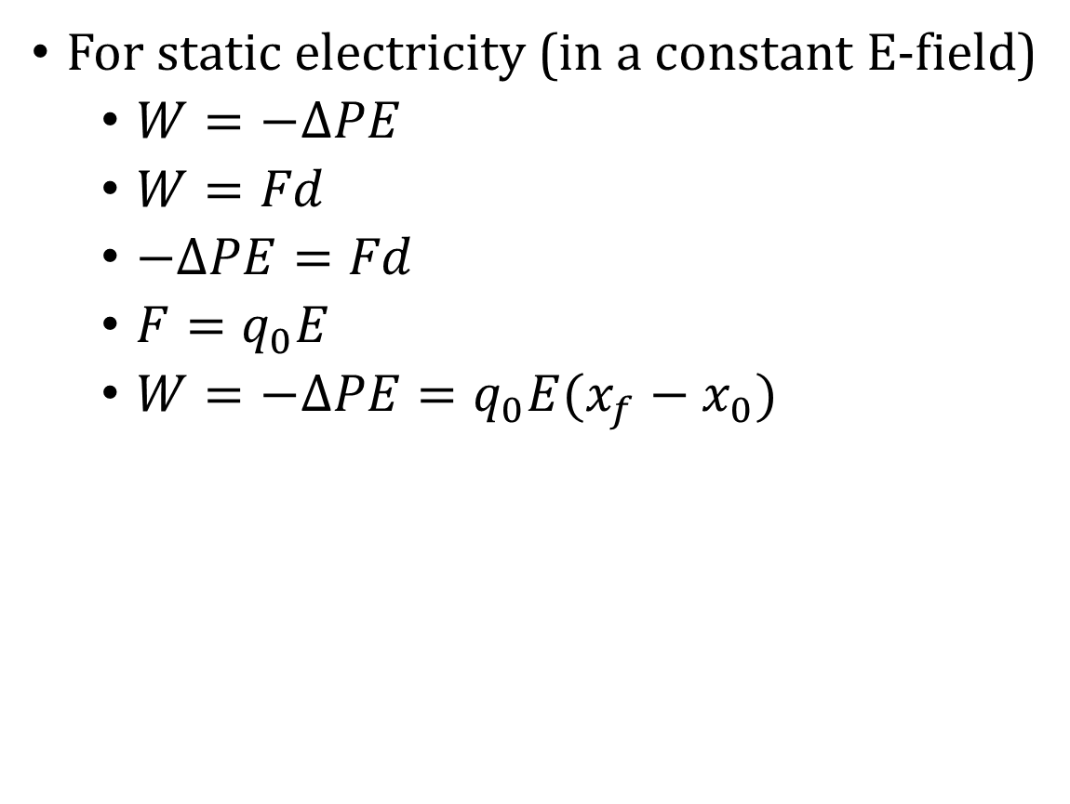
7-04 Electric Potential
For gravity (in a constant G-field)
$W=−ΔPE$
$W=Fd$
$−ΔPE=Fd$
$F=mg$
$W=−ΔPE=mg\left(y_{f}−y_{0}\right)$
For static electricity (in a constant E-field)
$W=−ΔPE$
$W=Fd$
$−ΔPE=Fd$
$F=q_{0}E$
$W=−ΔPE=q_{0}E(x_{f}−x_{0})$
PE can only be differences because there is no absolute zero position
Notes:
The sign is negative because the potential energy of the ball decreases as gravity does work to it (makes it come down).

Slide 42
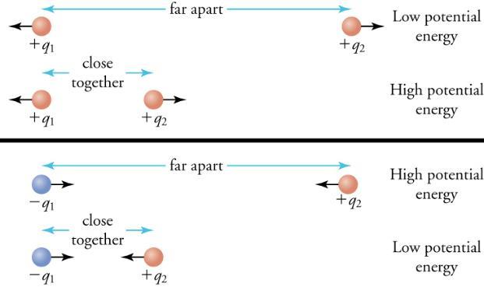
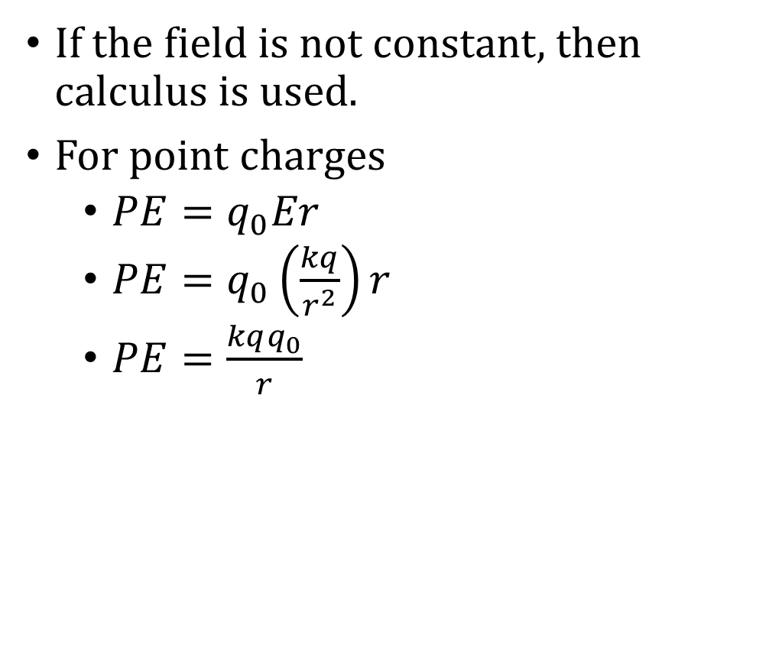
7-04 Electric Potential
If the field is not constant, then calculus is used.
For point charges
$PE=q_{0}Er$
$PE=q_{0}\left(\frac{kq}{r^{2}}\right)r$
$PE=\frac{kqq_{0}}{r}$

Slide 43
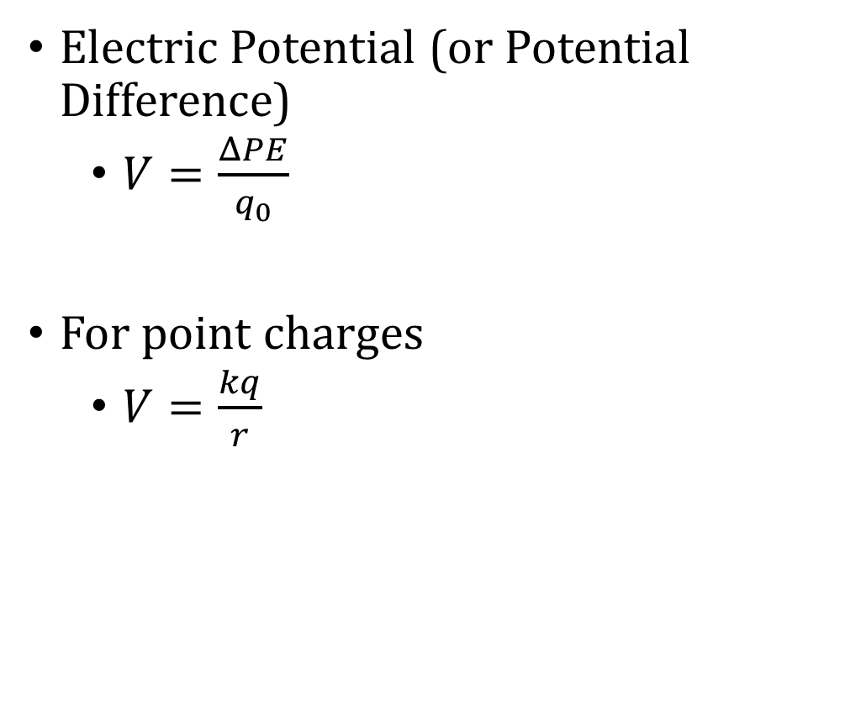
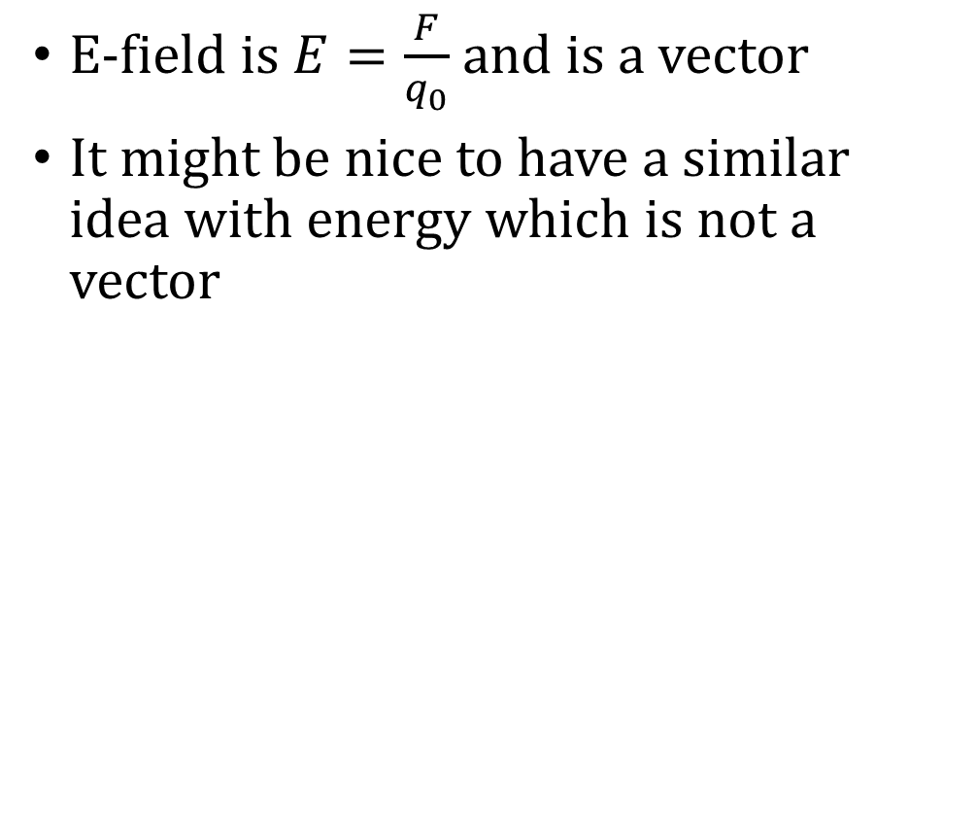
7-04 Electric Potential
E-field is $E=\frac{F}{q_{0}}$ and is a vector
It might be nice to have a similar idea with energy which is not a vector
Electric Potential (or Potential Difference)
$V=\frac{ΔPE}{q_{0}}$
For point charges
$V=\frac{kq}{r}$

Slide 44
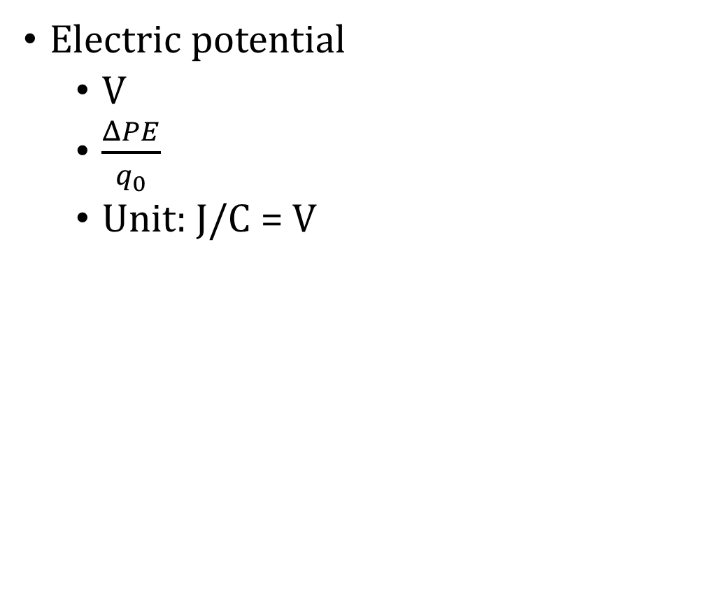
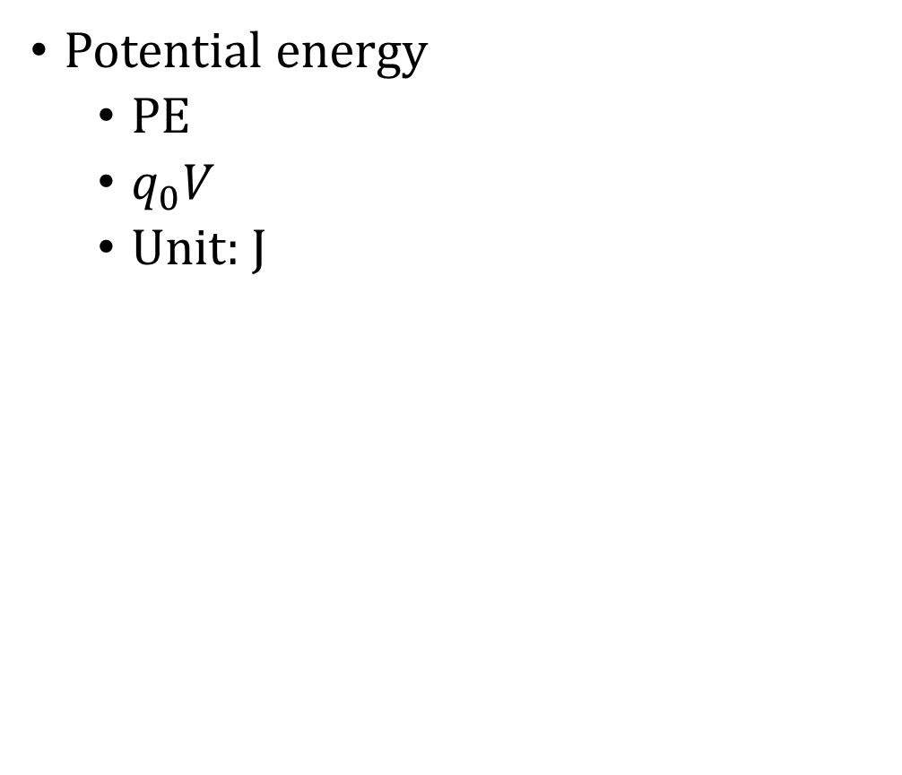
7-04 Electric Potential
Potential energy
PE
$q_{0}V$
Unit: J
Electric potential
V
$\frac{ΔPE}{q_{0}}$
Unit: J/C = V

Slide 45
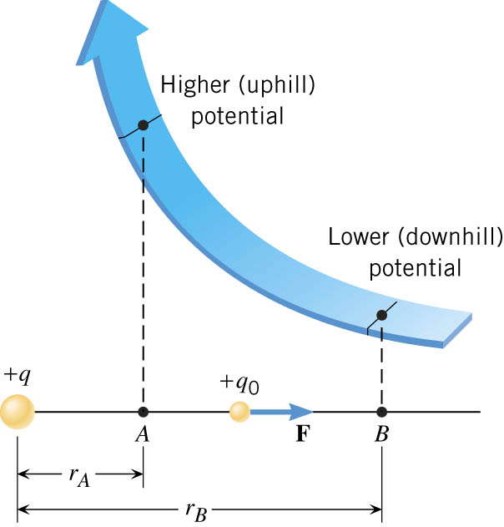
7-04 Electric Potential
Notes:
Charge at q
Two points at distances rA and rB
At both these points a small positive test charge is repelled by the force F = (kqq/r²)
This force does work to move the test charge from A to B
Since r varies from A to B and the force varies also, so must use calculus integrals to find the work done
W_{AB} = kqq₀/rA – kqq₀/rB
The potential difference can be found
V_{B} – V_{A} = -W_{AB}/q₀ = kq/rB – kq/rA
If we make rB very large (infinite) then kq/rB = 0 and V_{B} = 0
For convenience we always set V_{B} = 0 so
V = kq/r

Slide 46
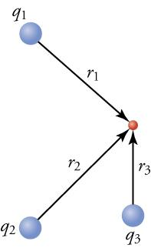
7-04 Electric Potential
To add potentials from several point charges, add the potentials at that point

Slide 47
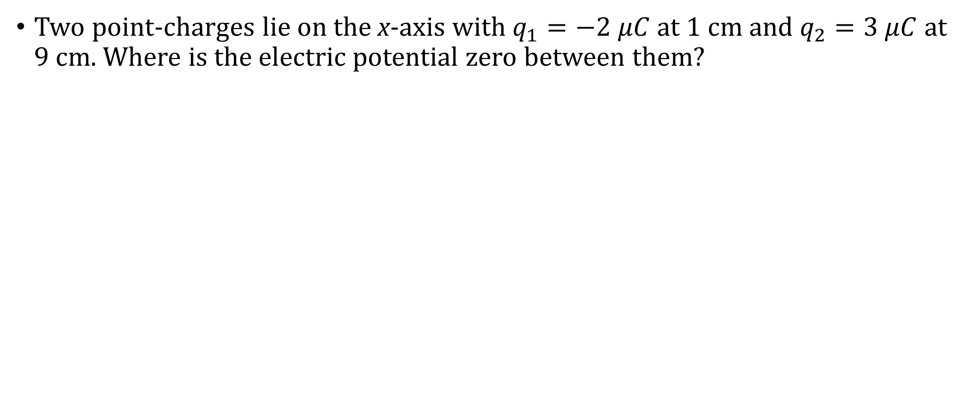
7-04 Electric Potential
Two point-charges lie on the x-axis with $q_{1}=−2 μC$ at 1 cm and $q_{2}=3 μC$ at 9 cm. Where is the electric potential zero between them?
Notes:
$$V=\frac{kq}{r}$$
$$V=\frac{k\left(−2×{10}^{−6} C\right)}{x}+\frac{k\left(3×{10}^{−6} C\right)}{8−x}=0$$
$$\frac{k\left(3×{10}^{−6} C\right)}{8−x}=\frac{k\left(2×{10}^{−6} C\right)}{x}$$
Cancel k and C and cross multiply
$$\left(3×{10}^{−6}\right)x=\left(2×{10}^{−6}\right)\left(8−x\right)$$
$$\left(3×{10}^{−6}\right)x=\left(16×{10}^{−6}\right)−\left(2×{10}^{−6}\right)x$$
$$\left(5×{10}^{−6}\right)x=16×{10}^{−6}$$
$$x=3.2 cm$$
Add 1 cm because the x was measured from 1 cm.
V is 0 at the 4.2 cm point

Slide 48
7-04 Practice Work
Electrify your brain and answer these problems
Read
OpenStax College Physics 2e 19.4
OR
OpenStax High School Physics 18.4

Slide 49
7-05 Potential and E-Field
In this lesson you will…
Understand the relationship between E-field, electric potential energy, and electric potential.
Draw equipotential lines around charges.
Notes:
OpenStax High School Physics 18.4
OpenStax College Physics 2e 19.4

Slide 50
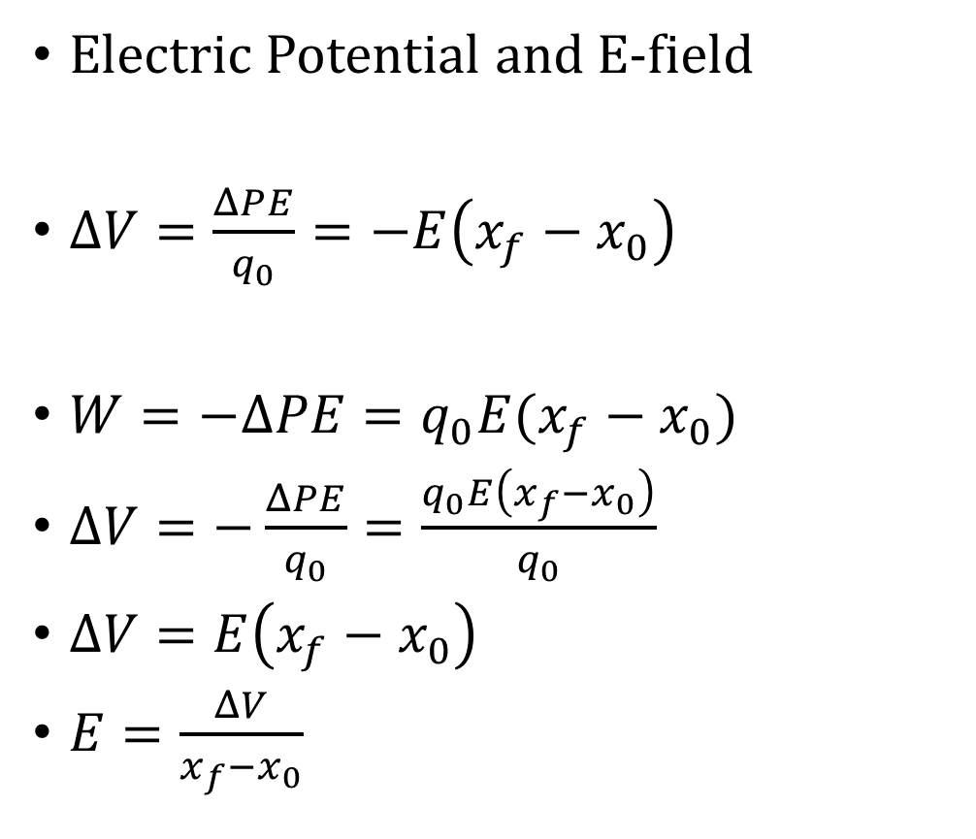
7-05 Potential and E-Field
Electric Potential and E-field
$ΔV=\frac{ΔPE}{q_{0}}=−E\left(x_{f}−x_{0}\right)$
$W=−ΔPE=q_{0}E(x_{f}−x_{0})$
$ΔV=−\frac{ΔPE}{q_{0}}=\frac{q_{0}E\left(x_{f}−x_{0}\right)}{q_{0}}$
$ΔV=E\left(x_{f}−x_{0}\right)$
$E=\frac{ΔV}{x_{f}−x_{0}}$
E-field units
N/C
V/m
It is easy to measure ΔV
To find E-field, divide ΔV and the distance between two points

Slide 51
7-05 Potential and E-Field
What is the voltage difference between the positions, x = 11 m and x = 5.0 m in an electric field of 2.0 N/C?
Notes:
$$E=\frac{ΔV}{x_{f}−x_{0}}$$
$$2.0\frac{N}{C}=\frac{ΔV}{11 m−5 m}$$
$$ΔV=12 V$$

Slide 52
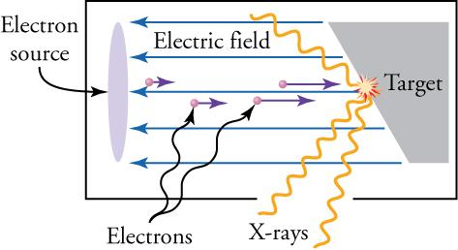
7-05 Potential and E-Field
X-ray tubes that generate X-rays contain an electron source separated by about 10 cm from a metallic target. The electrons are accelerated from the source to the target by a uniform electric field with a magnitude of about 100 kN/C. When the electrons hit the target, X-rays are produced. (a) What is the potential difference between the electron source and the metallic target? (b) What is the kinetic energy of the electrons when they reach the target, assuming that the electrons start at rest?
Notes:
$E=\frac{ΔV}{x_{f}−x_{0}}$ $100,000\frac{N}{C}=\frac{ΔV}{0.1 m}$ $10,000 V=ΔV$
$E_{0}+W_{nc}=E_{f}$ $PE_{0}+KE_{0}=PE_{f}+KE_{f}$ $0+0=q_{0}V+KE_{f}$ $KE_{f}=−q_{0}V$ $KE_{f}=−\left(−1.6×{10}^{−19} C\right)\left(10000 V\right)=1.6×{10}^{−15} J$

Slide 53
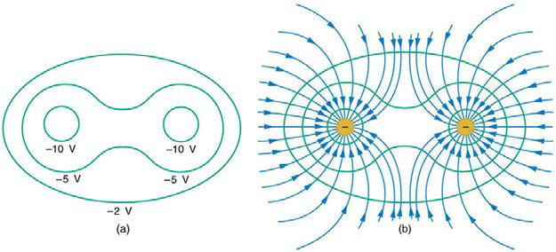

7-05 Potential and E-Field
Equipotential Lines
Lines where the electric potential is the same
Perpendicular to E-field
No work is required to move charge along equipotential line since $qΔV=0$

Slide 54
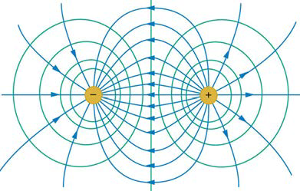
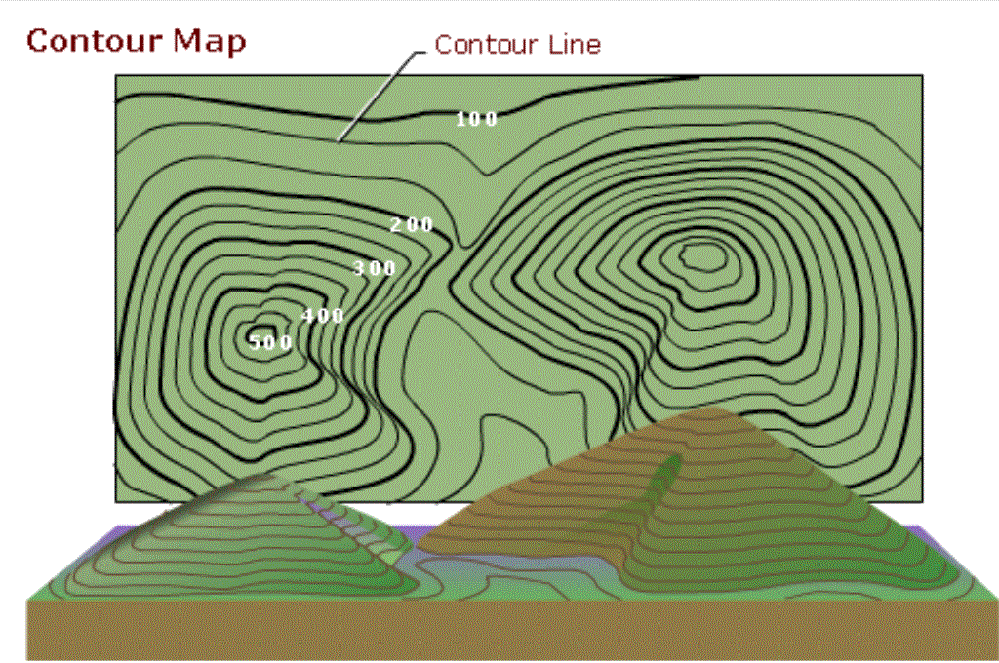
7-05 Potential and E-Field
Notes:
Field lines and equipotential lines like topographic map where altitudes are equipotential lines and slopes are like field lines

Slide 55
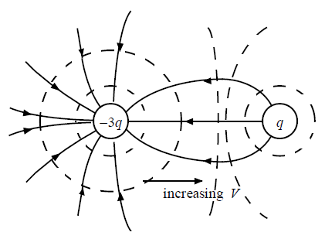
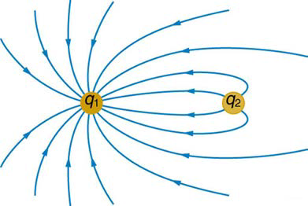
7-05 Practice Work
Sketch the equipotential lines in the vicinity of two opposite charges, where the negative charge is three times as great in magnitude as the positive.

Slide 56
7-05 Potential and E-Field
Let me charge you with this point: You can reach your potential.

